Slide 1
𝑬-𝕮𝒐𝒎𝒎𝒆𝒓𝒄𝒆 𝑷𝒓𝒐𝒅𝒖𝒄𝒕 𝑫𝒂𝒕𝒂 𝑨𝒏𝒂𝒍𝒚𝒔𝒊𝒔 𝒂𝒏𝒅 𝑴𝒂𝒄𝒉𝒊𝒏𝒆 𝑳𝒆𝒂𝒓𝒏𝒊𝒏𝒈

Slide 2
Introduction
This project is designed to analyze e-commerce product data and apply machine learning techniques to generate meaningful insights. The main objective is to study product pricing behavior and classify products as expensive or not based on their features.
The project follows an end-to-end data workflow, starting from web scraping and data preprocessing to statistical analysis, database storage, model development, and dashboard visualization.
Web scraping was performed to collect product data from an e-commerce website.
Using Python libraries such as requests and BeautifulSoup, product details including name, price, brand, category, and reviews were extracted automatically.
The collected data was then structured and stored in a CSV file for further processing. This process helped create a real-world dataset for analysis and model building.

Slide 3
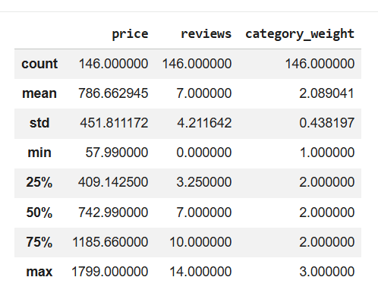
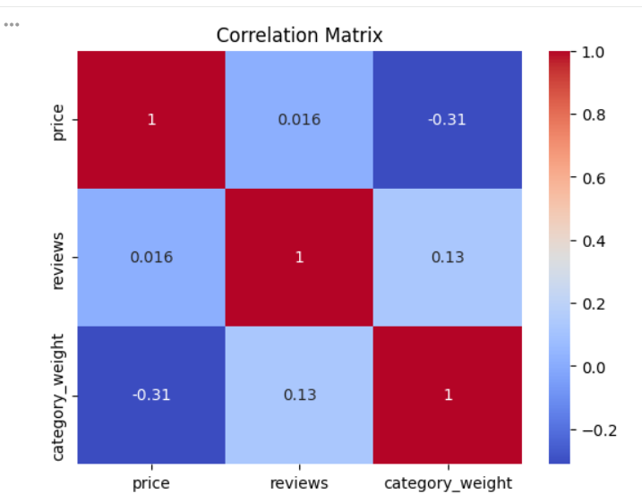
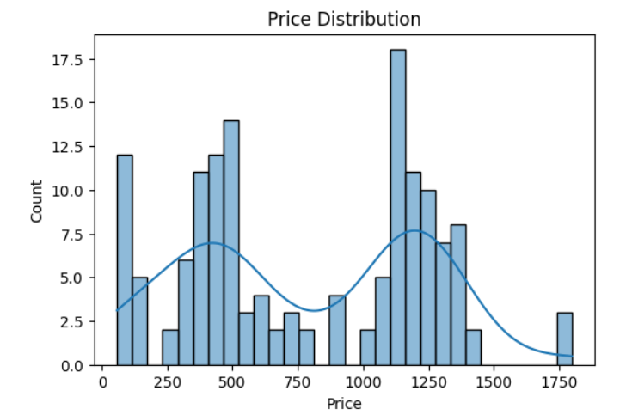
Data Cleaning and Statistical Analysis and Data storage
Data Cleaning
After collecting the raw data through web scraping, data cleaning was performed to ensure accuracy and consistency.
Missing values were handled, duplicate records were removed, and data types were converted appropriately (for example, price to float and reviews to integer).
Column names were standardized to maintain uniformity. These steps helped prepare the dataset for further analysis and modeling.
Statistical Analysis
Following data cleaning, Exploratory Data Analysis (EDA) was conducted to understand the distribution and relationships within the data.
Descriptive statistics such as mean, minimum, maximum, and standard deviation were calculated.
Visualizations like histograms and boxplots were used to analyze price and review distributions, while a correlation matrix was applied to examine relationships between numerical variables.
This analysis helped identify important patterns and trends in the dataset. Hypothesis testing was performed to statistically evaluate relationships and differences between variables in the dataset.
Data storage
After cleaning and analyzing the dataset, the processed data was stored in a MySQL database for structured management. A table was created with appropriate data types, and the cleaned data was inserted using MySQL Connector in Python.
SQL queries were used to retrieve insights such as total products and category-wise analysis, and the database was connected to Power BI for visualization.

Slide 4
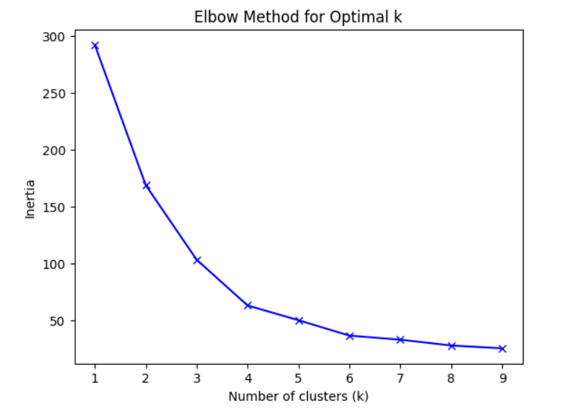
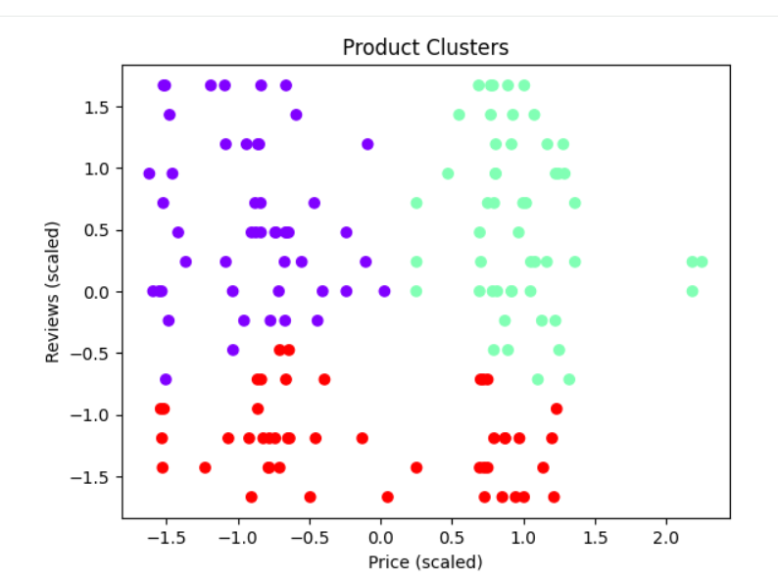
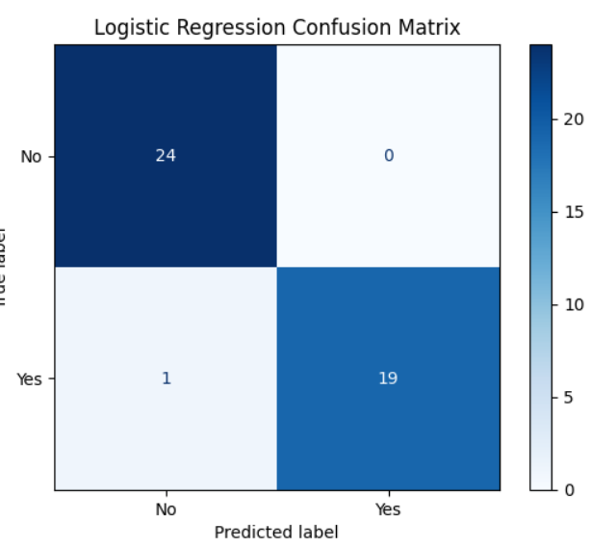
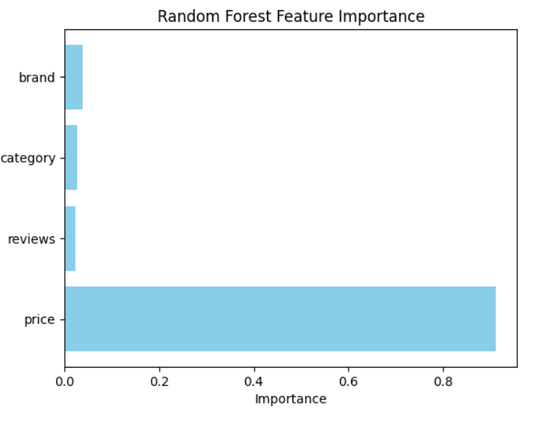
Unsupervised & Supervised Learning
In this project, K-Means clustering was used as an unsupervised learning technique to group products based on price and review similarities. Since unsupervised learning does not use predefined labels, the algorithm automatically identified patterns and formed clusters using distance-based calculations.
The Elbow Method was applied to determine the optimal number of clusters by analyzing inertia values. The point where the graph shows a clear bend indicates the best value of k. The Silhouette Score was also used to evaluate clustering quality, with the best performance observed at k = 4.
The cluster labels were generated automatically and not provided in the dataset, this approach uses unlabeled data and is considered unsupervised learning.
supervised learning was applied to classify whether a product is expensive or not using the labeled target variable is_expensive. Logistic Regression showed strong performance with only one misclassification in the confusion matrix and an excellent ROC curve.
SVM clearly separated the classes with a well-defined decision boundary. KNN achieved stable accuracy across different values of k. Random Forest analysis revealed that price is the most important feature, contributing the highest influence in prediction. Overall, the supervised models performed effectively on the dataset.

Slide 5
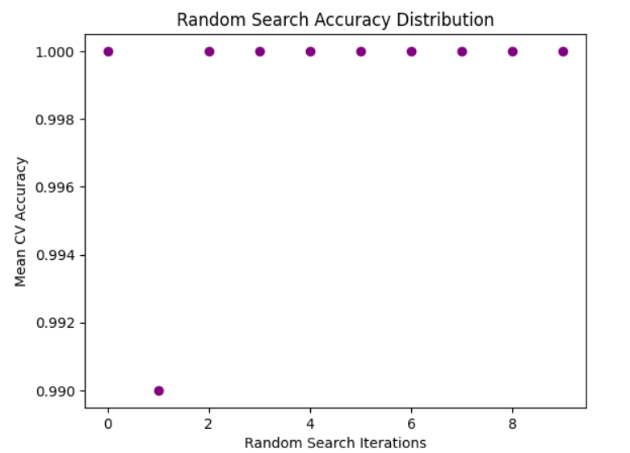
Hyperparameter Tuning
After building the supervised models, hyperparameter tuning was performed using Grid Search and Random Search to find the best combination of parameters.
Different values such as number of trees (n_estimators), max_depth, and split criteria were tested to improve model performance.
The tuned model achieved high accuracy and F1-score, indicating strong predictive performance. Feature importance analysis showed that price is the most influential factor in classifying whether a product is expensive or not.

Slide 6
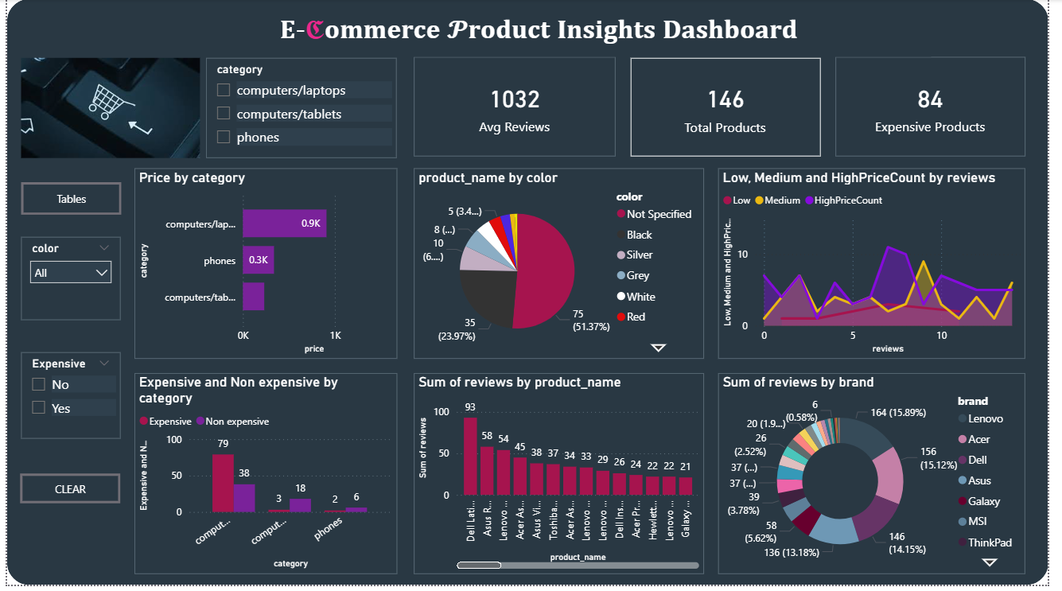
Power BI Dashboard
The final dashboard was developed in Power BI to present key insights from the e-commerce dataset in an interactive format. It highlights important metrics such as Total Products, Average Reviews, and Expensive Products using KPI cards.
Visualizations like bar charts, pie charts, and line graphs analyze price distribution, review patterns, brand performance, and category-wise comparisons. Filters for category, color, and price type enable dynamic data exploration.
Overall, the dashboard converts analytical results into clear business insights for better decision-making.

